Slide 1
Data Analysis & Story Stelling on Office Suppliers Case Study
- Dhruv
- Nikita
- Rohan
-Sharon

Slide 2
OBJECTIVE
Provide strategies to the management in order to improve sales and increase the revenue.
Understand the data and provide insights to the stakeholders
Perform qualitative and quantitative analysis on data

Slide 3
DATA ANALYSIS: DATA UNDERSTANDING/REVIEW
The quality of data provided is good. Null values and errors were low.
The columns are defined with correct datatypes.
Only the variable “Pin code” has missing values (41296 or 80.51%). However the variable Pin code is not having any significance in the analysis.

Slide 4
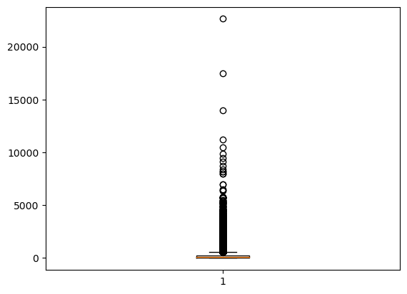
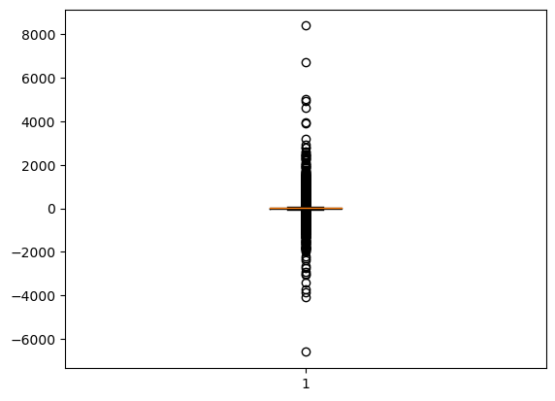
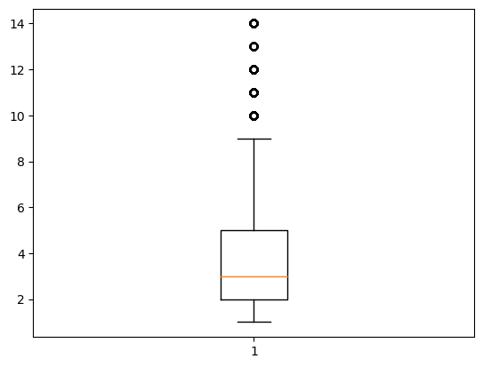
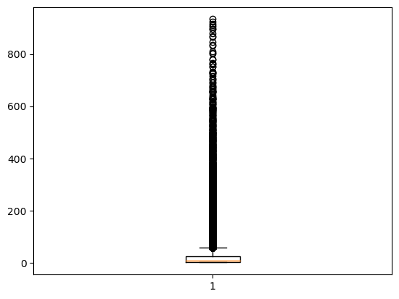
DATA ANLYSIS: OUTLIERS
Outliers: We have outliers present in Sales, Profit, Quantity and Shipping Cost.
The outliers are normal when we consider the nature of data, For example for a high quantity order, the sales, profit and shipping cost can be higher. Also, it is not necessary this order quantity should happened frequently.

Slide 5
DATA PREPARATION
Measures created
Calculated Columns
Profit and Loss
Order year
Shipping Year
Order Type
Shipping Days
Average Discount | Average Sales | Distinct Customer ID Count
Difference b/w order – shipping dates | Distinct Product ID Count | Total Sales
Total order ID count | Total Order per customer | Total Profit
Total Quantity | Total Shipping Cost

Slide 6
DATA ANALYSIS: EDA & DATA CLEANING
We checked for duplicates and didn’t found any.
Checked for empty values - Postal Code is removed.
Customer name is removed as we have customer ID as unique value.
We will make 2 hierarchies – City, State, Country, Market & Category , Subcategory.
Feature Engineering – derived column for profit and loss(using IF function).

Slide 7
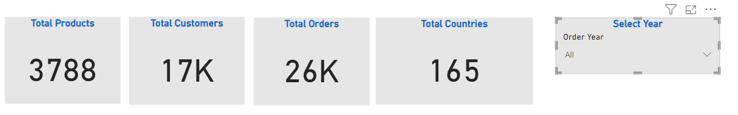
DASHBOARD PREPARATION
In the first report we have an overview of the Office Supply Data Set.

Slide 8
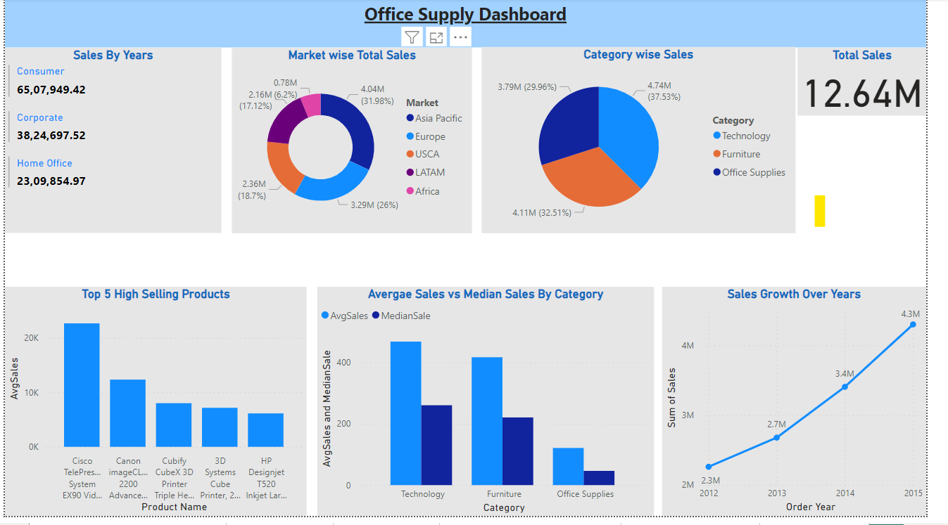
DASHBOARD: SALES ANALYSIS
We have growth in sales year by year.
Considerable sales in Asia Pacific and Europe Market, but Africa is still to be captured.
Technology is the highest selling category followed by Furniture and Office Supplies
We can see outliers present in the sales data from average and Median sales.

Slide 9
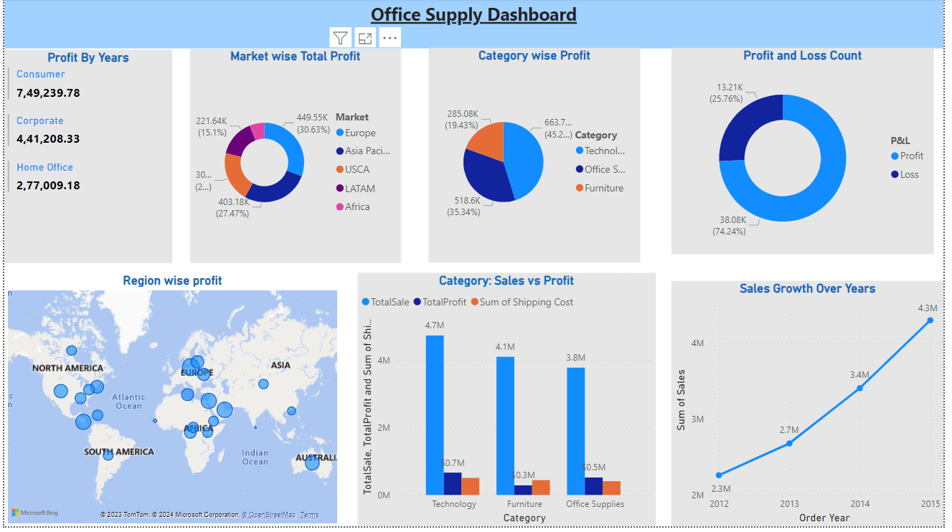
DASHBOARD: PROFIT ANALYSIS
Profit is increasing year by year but we have 13k orders ended in Loss. Need to address this issue.
Even though furniture is the second highest selling category, it is generating the lowest profit.

Slide 10
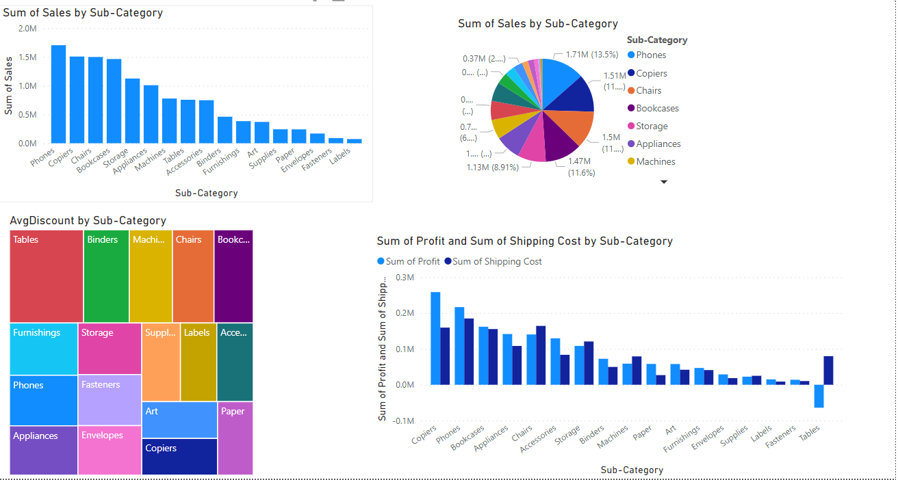
DASHBOARD: SUB CATEGORY ANALYSIS

Slide 11
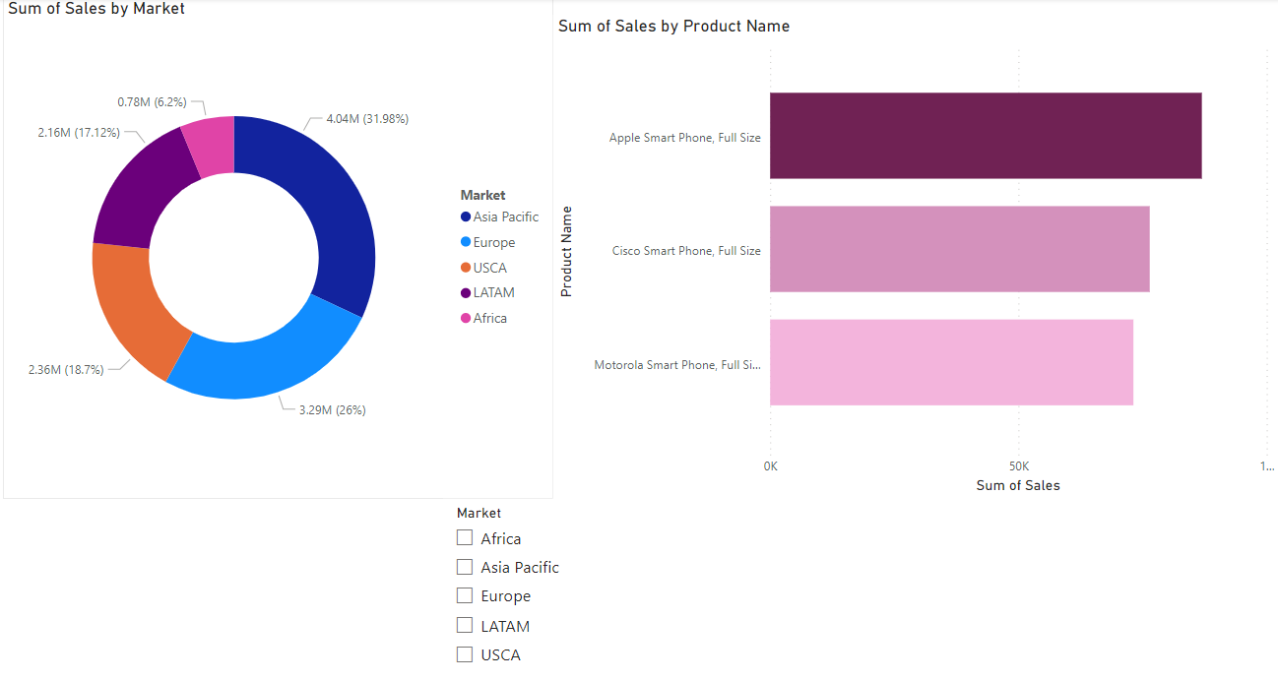
DASHBOARD: MARKET ANALYSIS

